Slide 1

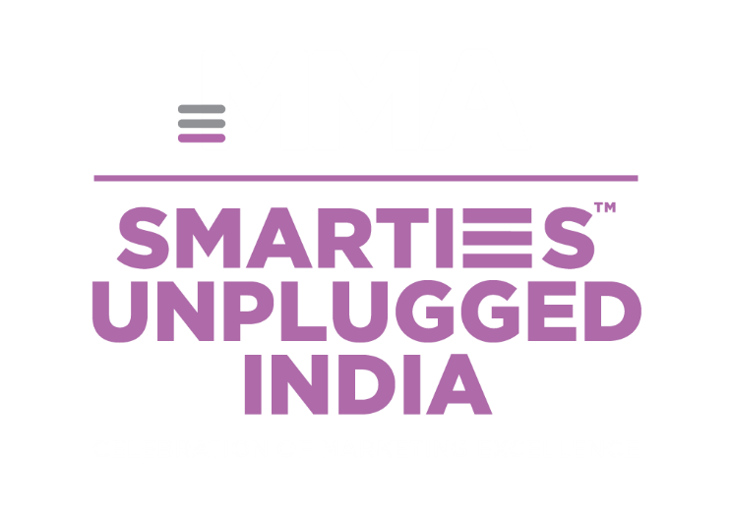

KNOWLEDGE SESSION BY

Slide 2


Toluna’s role at SMARTIES 2025
1
Observe Jury Discussions (Pre-Event)
2
Share Jury Thinking & Trends (During-Event)
    Themes and learnings, not winners or case details.
3
Share Whitepapers / Insight Decks (Post-Event)
    Detailed case studies and Insights from this year’s entries & winners

Slide 3
Diverse and Powerful Jury
1
2
Robust Jury Size
Senior Leadership at the Helm
  Chaired by top leaders (CMO/MD/AVP level) ensuring strategic lens in evaluation.
  30+ members bring depth, ensuring multiple perspectives on each case.
3
4
Cross-Sector Diversity
Balanced Ecosystem Representation
  Jury spans industries like FMCG, automotive, aviation, tech, finance, hospitality, and e-commerce, ensuring broad evaluation lenses..
  Strong mix of brands, media, tech, agency leaders.
  Balance of creativity, business impact & technical execution perspectives.

Slide 4









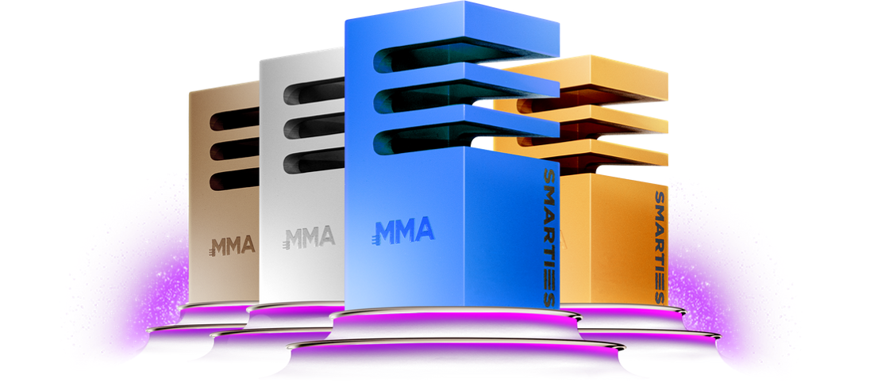
Winners came from a wide variety of categories, including local, regional and global brands
showing the breadth of entries this year
Pharma
Beverages
Auto
Tech
Finance
Personal Care
Real Estate

Slide 5



Storytelling + Business Impact = The Sweet Spot
Clear preference for ROI & Sales lift → Campaigns penalized if impact was unclear
Cultural or emotional stories resonate & drive conviction
  “This is culture meets brand meets AI—beautiful storytelling with numbers to prove it worked.”
  “They didn’t just show the tech, they connected it to the consumer journey. Story plus outcome.”
“[Brand ] is very ROI positive in that sense and that business impact is clear. So Brand X at #1 for me.”
“1,700 bookings in 24 hrs, for a category with a 3–5 month purchase cycle, that’s huge.”

Slide 6

ALL WINNERS WERE BASED ON A GENUINE CONSUMER INSIGHT
Powerful insights, woven into well-crafted executions
Some were very localized, very specific giving the campaigns crystal clear objectives

Slide 7
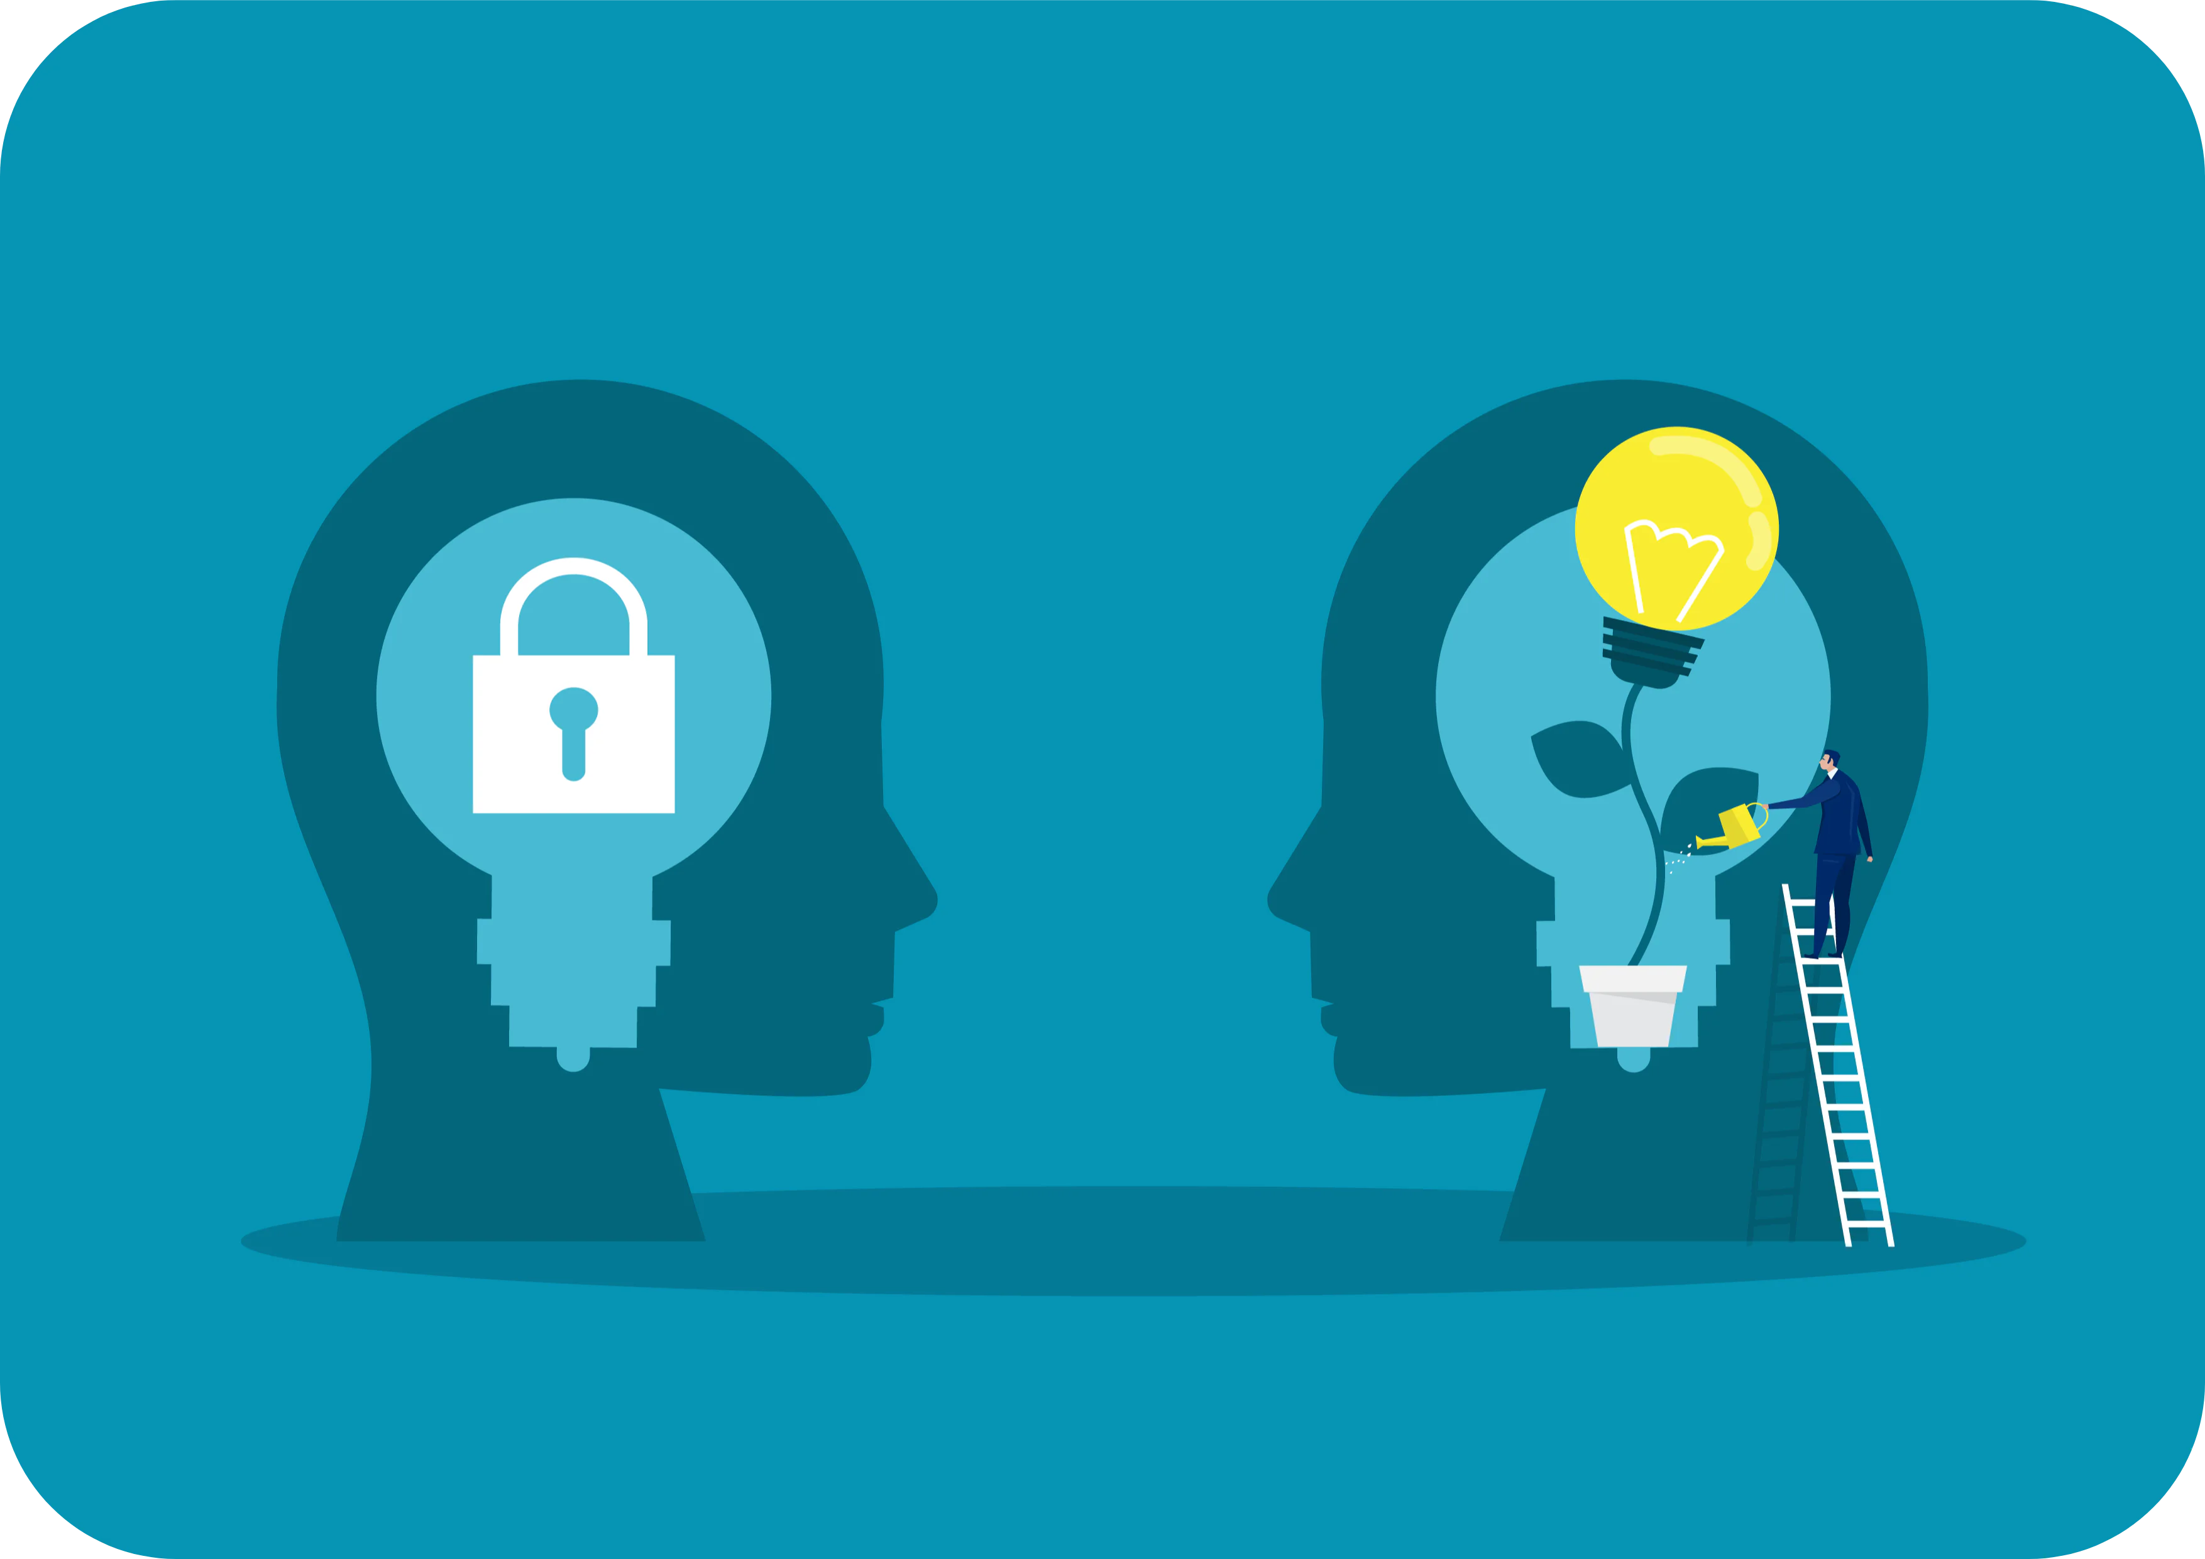

Purpose-Led Marketing Must Go Beyond Communication → It Needs Real-World Impact
Authentic, action-oriented brand purpose is what earns consumer trust and recognition — not mere messaging.
Campaigns that solve real problems, change behaviours, or drive societal good resonated far more than CSR-style narratives.
“One is about talking purpose, and I feel some brands have gone ahead and actually done something about it. [Brand] has saved precious time — that’s action, not talk.”

Slide 8

Everyday Impact OR Solving day-to-day frictions → as Powerful as Big Purpose
Some of the most celebrated campaigns were those addressing mundane but real pain points — proving that purpose doesn’t have to be grandiose to be effective.
REAL – TANGIBLE IMPACT
Small, tangible interventions that improve everyday life can drive massive brand love and loyalty.
  “In my life it’s made a big difference. I think it is certainly saved precious time and a lot of [effort]. Well identified opportunity, action more than talk.”
  “Picking real, topical subjects like [impact] brings a whole new dimension to relevance.”

Slide 9

Continuity Builds Trust — But Evolution Keeps It Relevant
The jury valued brands that demonstrated sustained commitment to a purpose or platform → but only if they kept adding new layers of impact each year.
Repetition without reinvention was penalised.
“Some submissions showed tremendous continuity in how they evolved purpose — that’s powerful.”
“It’s impressive when a brand builds on the foundation instead of starting from scratch each time.”
“Continuity alone is not enough — the next chapter must still surprise and deliver.”

Slide 10



AI is Moving from Buzzword to Business Tool
Campaigns leveraging AI effectively for personalization, cultural integration, and business outcomes were rated highly, while superficial uses of AI were challenged.
“The use of AI bang on, integration with the brand platform, culture meets brand meets AI.”
“[Brand’s] use of AI stood out because it drove tangible business results.”
“It feels like they added AI in to make it sound fancy, but it didn’t change the outcome.”
“If AI doesn’t move the business needle or the consumer experience, it’s just tech-washing.”

Slide 11

Bringing Online and Offline Together
Some brands planned a perfectly timed integration between real time data/insight and its offline actionability, doing away with any lead time between the two

Slide 12
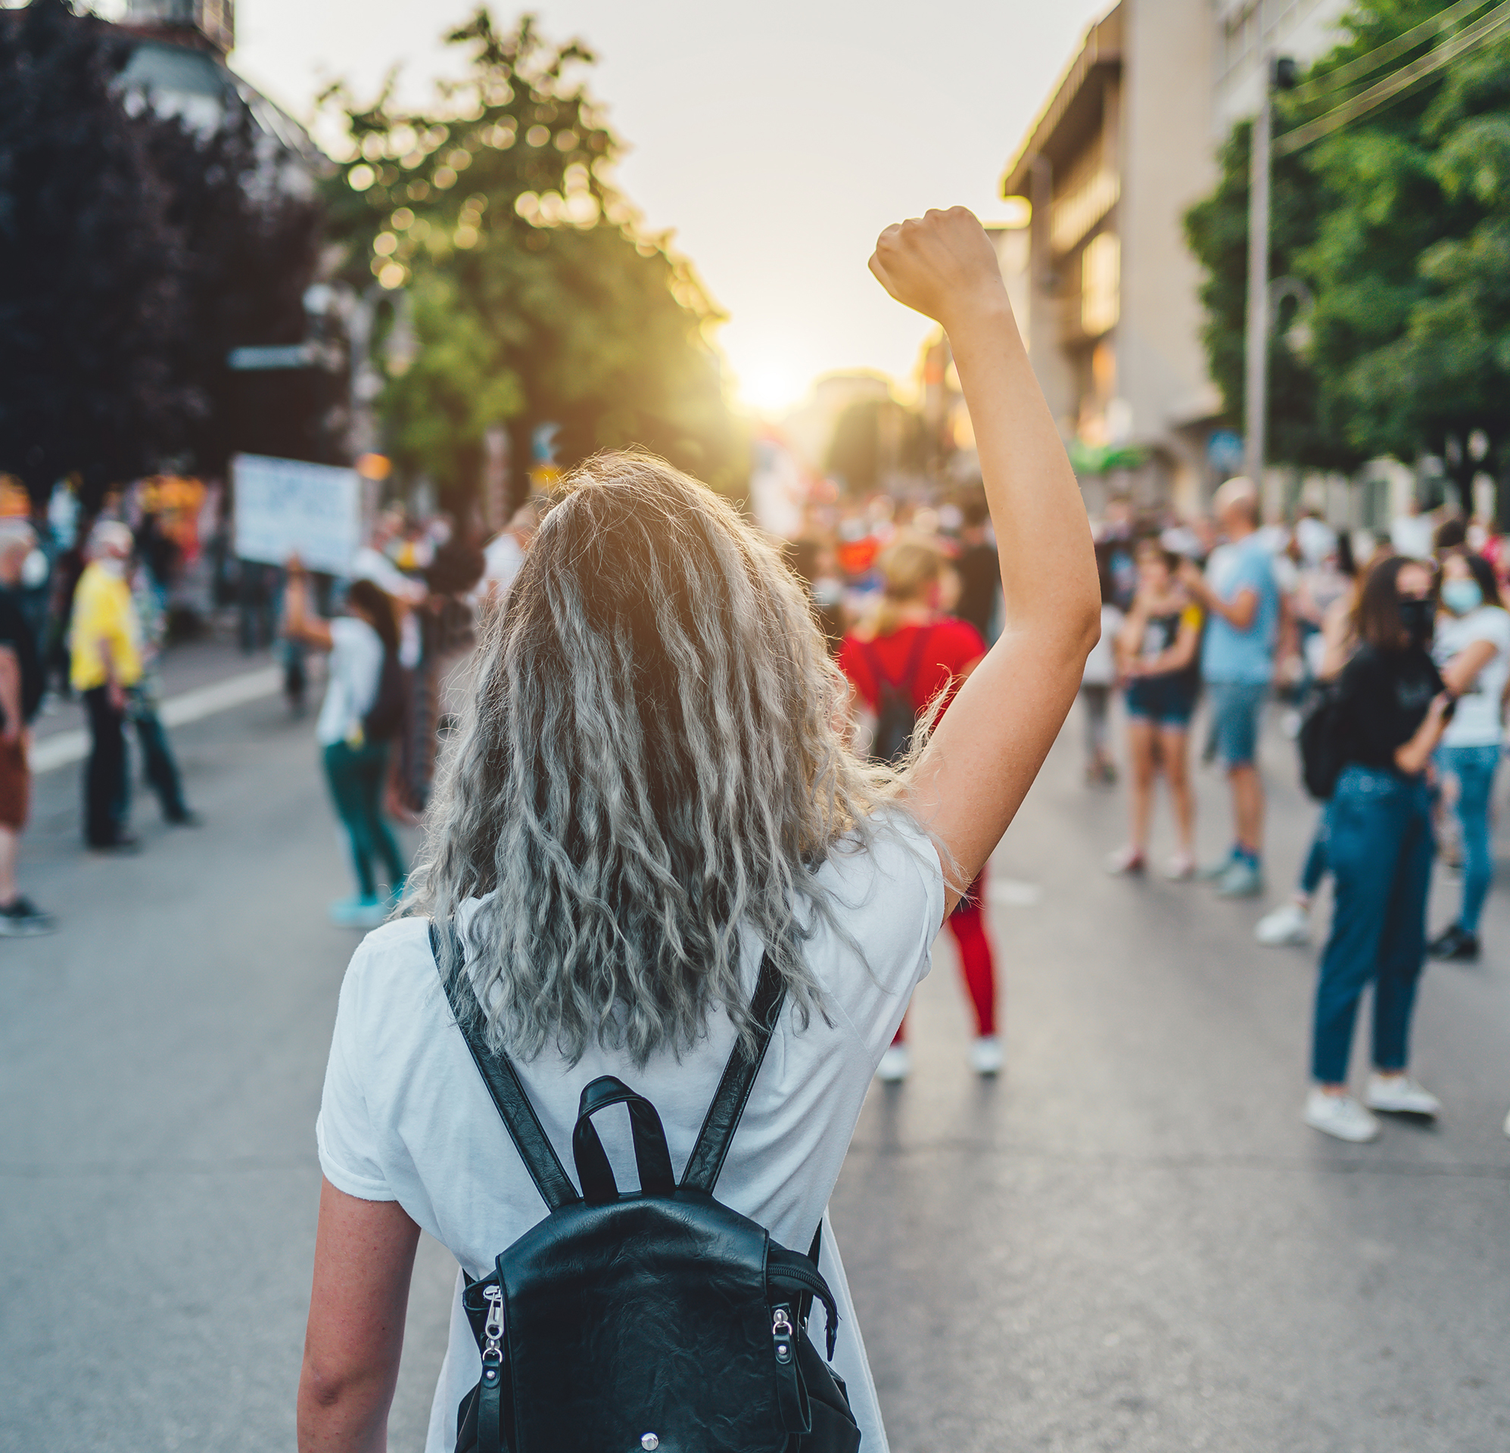
Social Activism Campaigns Are Evolving — From Awareness to Advocacy
“It’s not about purpose as a tagline. It’s about purpose as a product, service, or system that genuinely changes lives”
The jury valued campaigns that moved beyond storytelling to actively shift mindsets, influence behaviour, or challenge norms — especially in sensitive areas like identity, or inclusion.

Slide 13
Creative Excellence Still Matters — A Strong Idea Can Be Weakened by Weak Execution
“The reason I penalized [Brand] is for the quality of the creative and I just felt that they didn’t do a good job of what was fundamentally a good idea.”
“Creatively not, I wouldn’t say top of the pop, but at least picking the right topical subjects… I found that they are taking action and bringing relevance, but creatively it was weaker.”
Even when the underlying idea is powerful or socially relevant, creative and executional finesse often determine whether it resonates.
Otherwise strong campaigns were penalized for poor storytelling.

Slide 14
Key Learnings Summarized…
Embed purpose into your business. Create tangible impact
Take steps to solve everyday consumer problems
Invest in powerful storytelling
Harness AI Technology meaningfully
Build your brand with continuity, but evolve to be relevant
INVEST IN CREATIVE EXCELLENCE — execution quality drives resonance

