Slide 1
RCS OVERVIEW
Jon Campbell
Rich Messaging Product Director
Copyright© 2018 Sinch. All rights reserved.

Slide 2
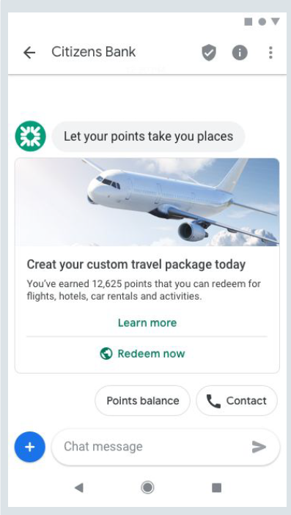
RCS Messaging The alternative to apps
Verified sender
Providing trust and assurance
Branding
Name, logo, colors
Interactive conversations
Automate dialogues with customers
Carousels
Swipe options
Richer media
Text, audio, images, videos, links
Suggested actions and replies
Call to actions and quick replies
Copyright© 2018 Sinch. All rights reserved.

Slide 3
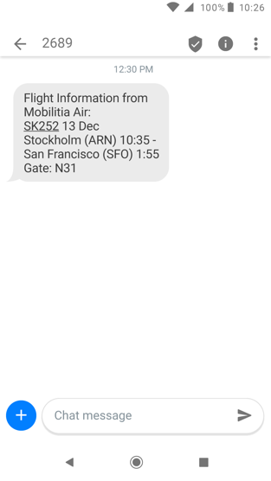
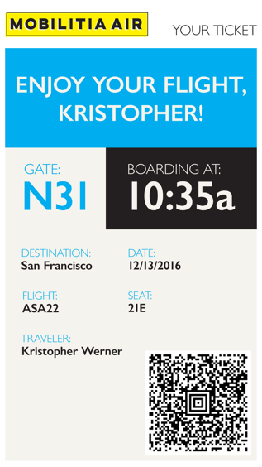
From 160 characters to
rich media messages
Copyright© 2018 Sinch. All rights reserved.
Notes:
Existing use cases & new use cases

Slide 4
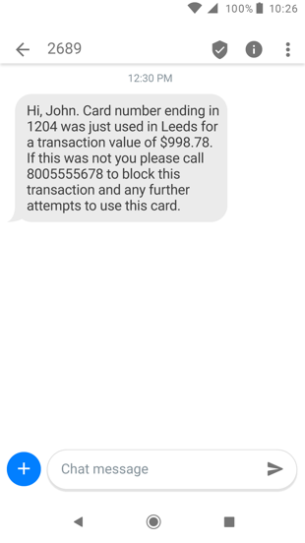
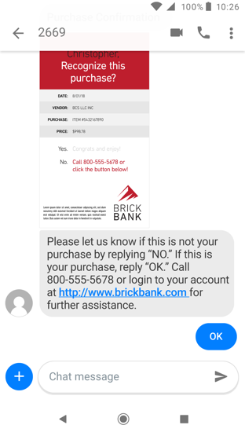
From 1-way notifications to
2-way conversations
Copyright© 2018 Sinch. All rights reserved.
Notes:
Enriching the engagement with a customer

Slide 5
Clothing retailer with CRM data launches new campaign
…with personalized content
Copyright© 2018 Sinch. All rights reserved.

Slide 6
Clothing retailer with CRM data launches new campaign
…with interactive purchase and post-purchase
messaging
Copyright© 2018 Sinch. All rights reserved.

Slide 7
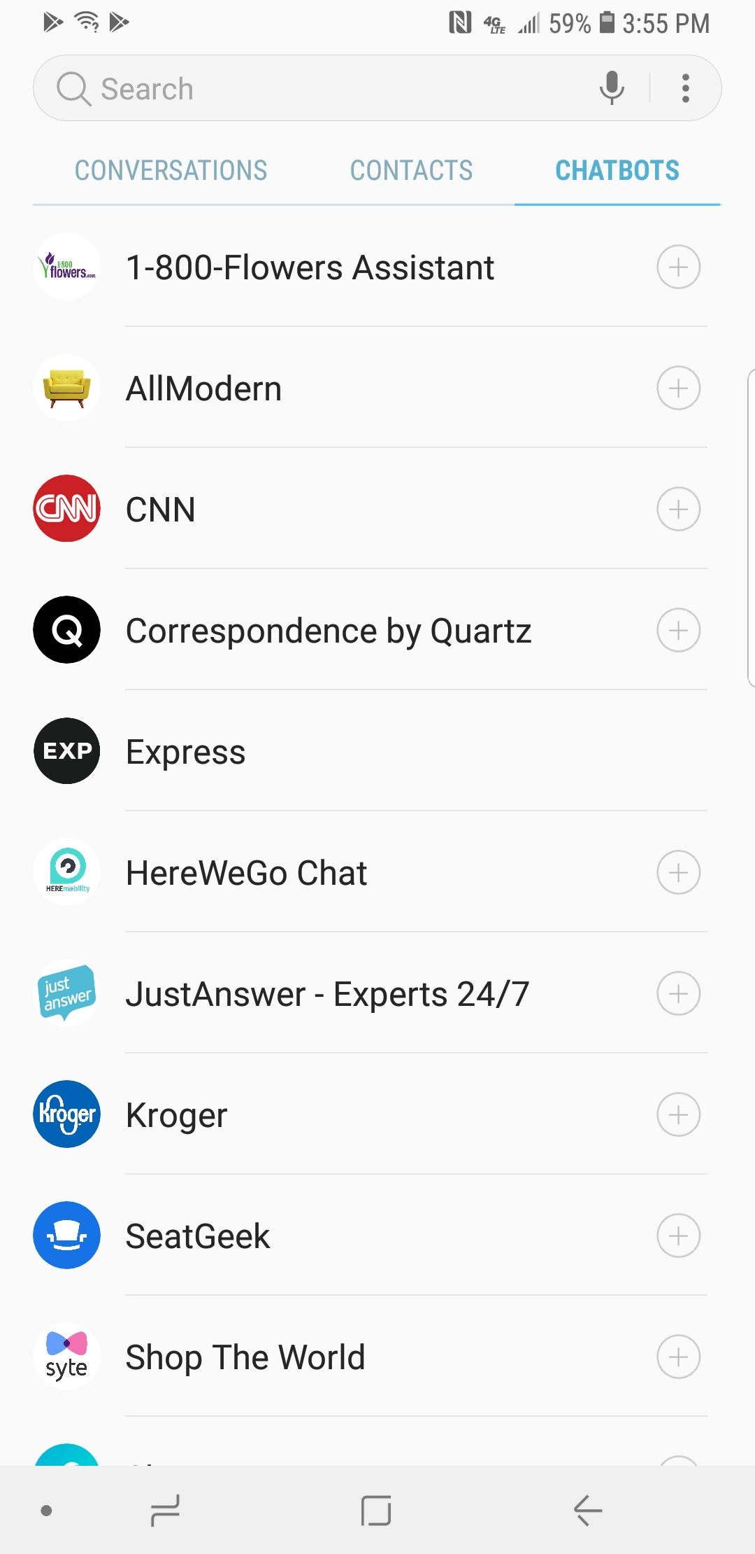
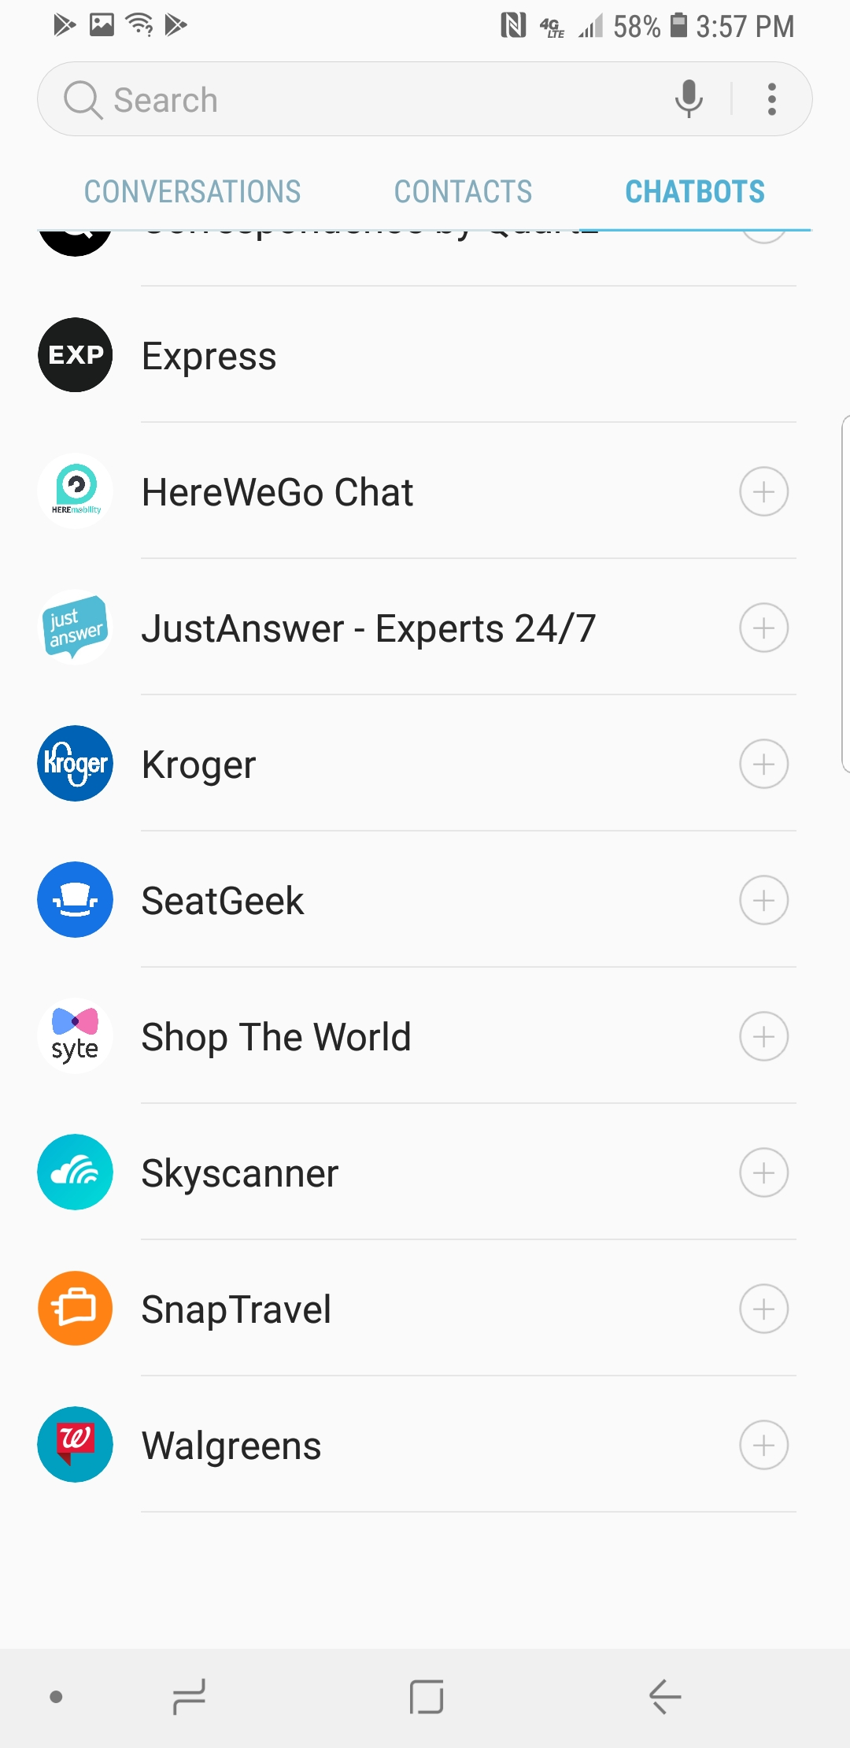
Chatbot Directory (P2A General Theme)
Copyright© 2018 Sinch. All rights reserved.

Slide 8
Omni-channel strategy Cost efficient integration to messaging channels
Business System A
Business System B
Business System C
Business System A
Business System B
Business System C
Omni channel API
SMS
RCS
SMS
RCS
MMS
APP
MMS
APP
Copyright© 2018 Sinch. All rights reserved.

Slide 9
Copyright© 2018 Sinch. All rights reserved.

Slide 10
RCS Ecosystem
Copyright© 2018 Sinch. All rights reserved.

Slide 11
RCS Ecosystem Roles and Functions
Service Providers
Chatbot
Platforms
Engagement
Platforms
Brands
Aggregators
Verification
Authorities
Mobile Operator
Mobile Operator
MaaP
MaaP
RCS Servers
RCS Servers
RCS Hubs
RCS Devices
RCS Devices
Copyright© 2018 Sinch. All rights reserved.

Slide 12
Universal Profile
Features for chatbots and RCS Business Messaging
Improved Chatbot features
Rich features comparable with OTT Messaging
Universal Profile 2.2
June 2018
Universal Profile 2.0
June 2017
Universal Profile 1.0
October 2016
Copyright© 2018 Sinch. All rights reserved.
Notes:
A single, industry-agreed set of features and technical enablers developed to simplify the product development and global operator deployment of RCS
Should by minimum use UP 2.0

Slide 13
RCS Verified Sender
Universal Profile 2.2 introduces the concept of Verification Authorities that verify whether the Chatbot is entitled to use the name and logo.
Currently under discussions and review within GSMA
A Verification Authority could be, but is not limited to, a commercial business, for example
verification companies from the internet world
an operator
a government department.
Copyright© 2018 Sinch. All rights reserved.
Notes:
Spam and SMiShing are becoming a concerning issue which could potentially put MNO messaging at risk. SMS remains an important element of the messaging ecosystem, but it does not allow the recipient to confirm the identity of the sender. This can now be addressed under RCS

Slide 14
Business Case & Commercial Models
Copyright© 2018 Sinch. All rights reserved.

Slide 15
Proposed RCS charging model
MT CHARGED
x 1.2 A2P SMS
1
STATUS NOT CHARGED
ACME
MO NOT CHARGED
2
MT (within x hours) TRIGGERS SESSION
x 3 A2P SMS
3
Session lasts X hours
Copyright© 2018 Sinch. All rights reserved.

Slide 16
RCS Business Messaging Revenue Potential
Future potential revenues as ecosystem evolve
$15.8bn Digital Virtual Assistant
Market 2021
$100bn Search
Paid Search 2017
Existing Revenue Opportunity
>$7bn* RCS Business Messaging
2022 potential
>$17bn* SMS Business Messaging
Today
Copyright© 2018 Sinch. All rights reserved.

Slide 17
Average global A2P brand/consumer engagement is approx. 3 per month. By 2023 this will by 30 per month*
*Mobile Squared, MWC 2019
Copyright© 2018 Sinch. All rights reserved.

Slide 18
For the next 3-4 years, business messaging spend on WhatsApp forecasted to exceed $30Billion (cumulative)*
*Mobile Squared, MWC 2019
Copyright© 2018 Sinch. All rights reserved.

Slide 19
Network Support
The given operator must support A2P RCS and the GSMA Universal Profile
Device support
The majority of new Android clients <2 years old already support RCS.
Content
The possibilities for content and dialogue are almost infinite
Copyright© 2018 Sinch. All rights reserved.

Slide 20
Further information
API here:
https://www.sinch.com/docs/rcs/index.html
Demonstration here:
https://www.sinch.com/products/messaging/rcs/
GSMA Information:
https://www.gsma.com/futurenetworks/rcs/
Copyright© 2018 Sinch. All rights reserved.

