Slide 1
Confidential & Proprietary © 2019 Vehicle

Slide 2
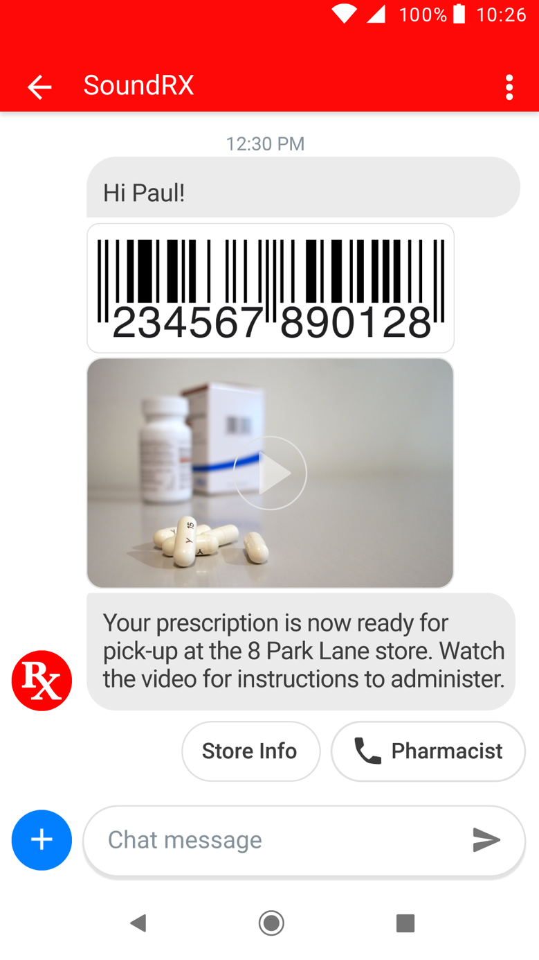
rcs interactive messaging
SYNCHRONOUS CONNECTION
Interactive typing indicators, content updates (ex. coupons), delivery and read receipts
Web and app-like interactive messaging experience in the phone’s native SMS app
RCS initiates engagement, whereas web/app requires customer to initiate engagement
Broadcast (A2P) RCS push to database
Branded native SMS app chatbot (P2A)
BRANDING
Name, colors, logo, icons customized to match brand graphic identity
DYNAMIC RICH CONTENT
Dynamic text, images, videos, animations, passes, unique barcoded coupons, loyalty cards, tickets and more with integrated dynamic fields
QUICK REPLY CHIP
Button click sends rich media or text reply within conversation
SUGGESTED ACTION CHIP
Icon button deep links directly to interactive apps ex. maps, dialer, or any web page or service

Slide 3
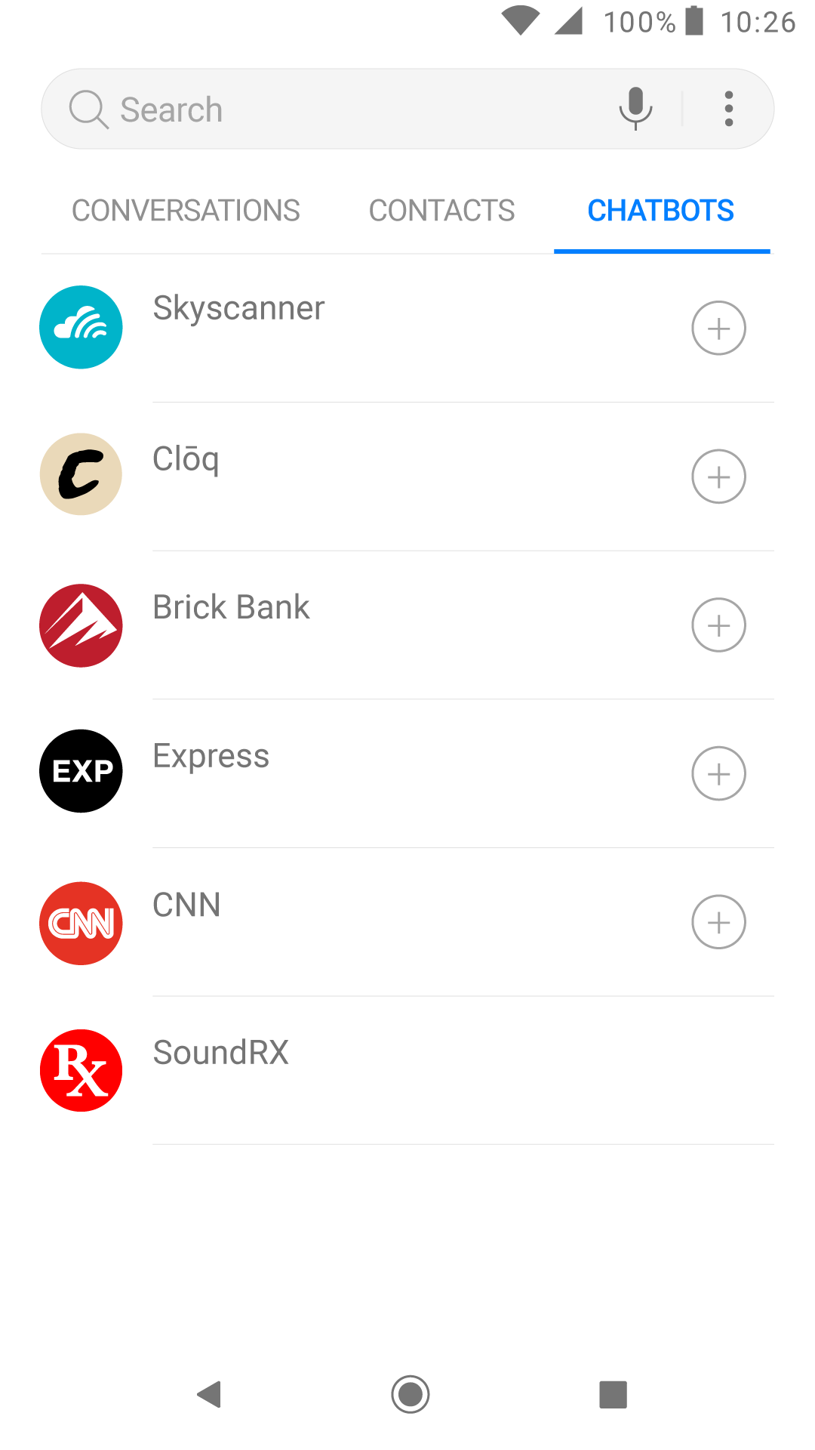
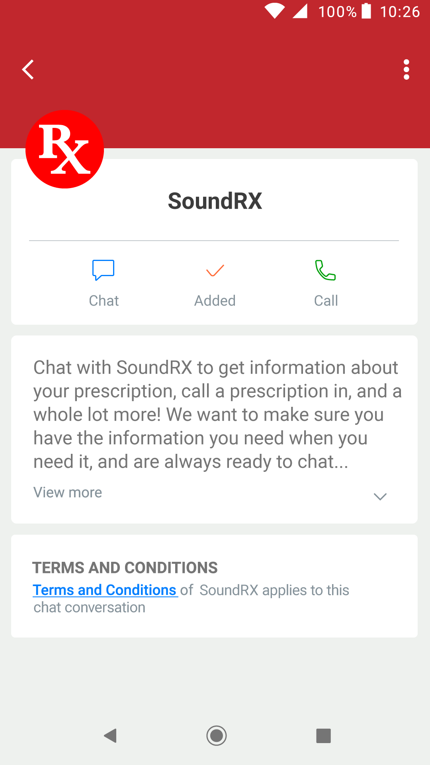
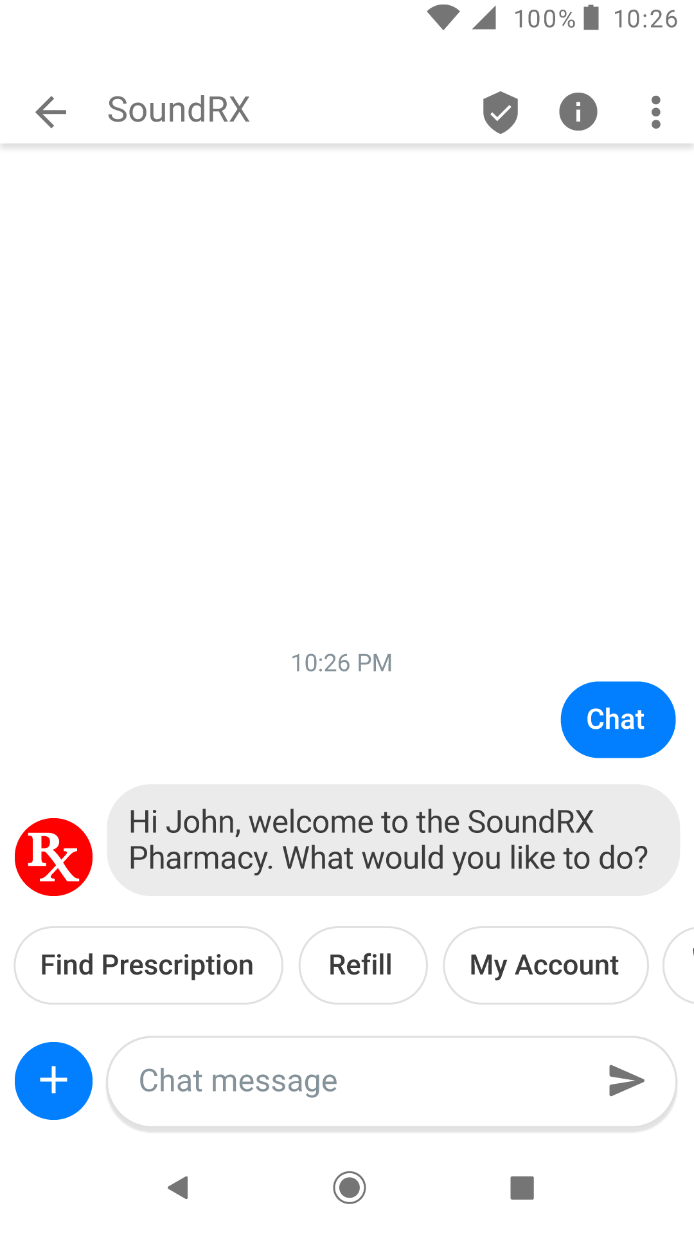
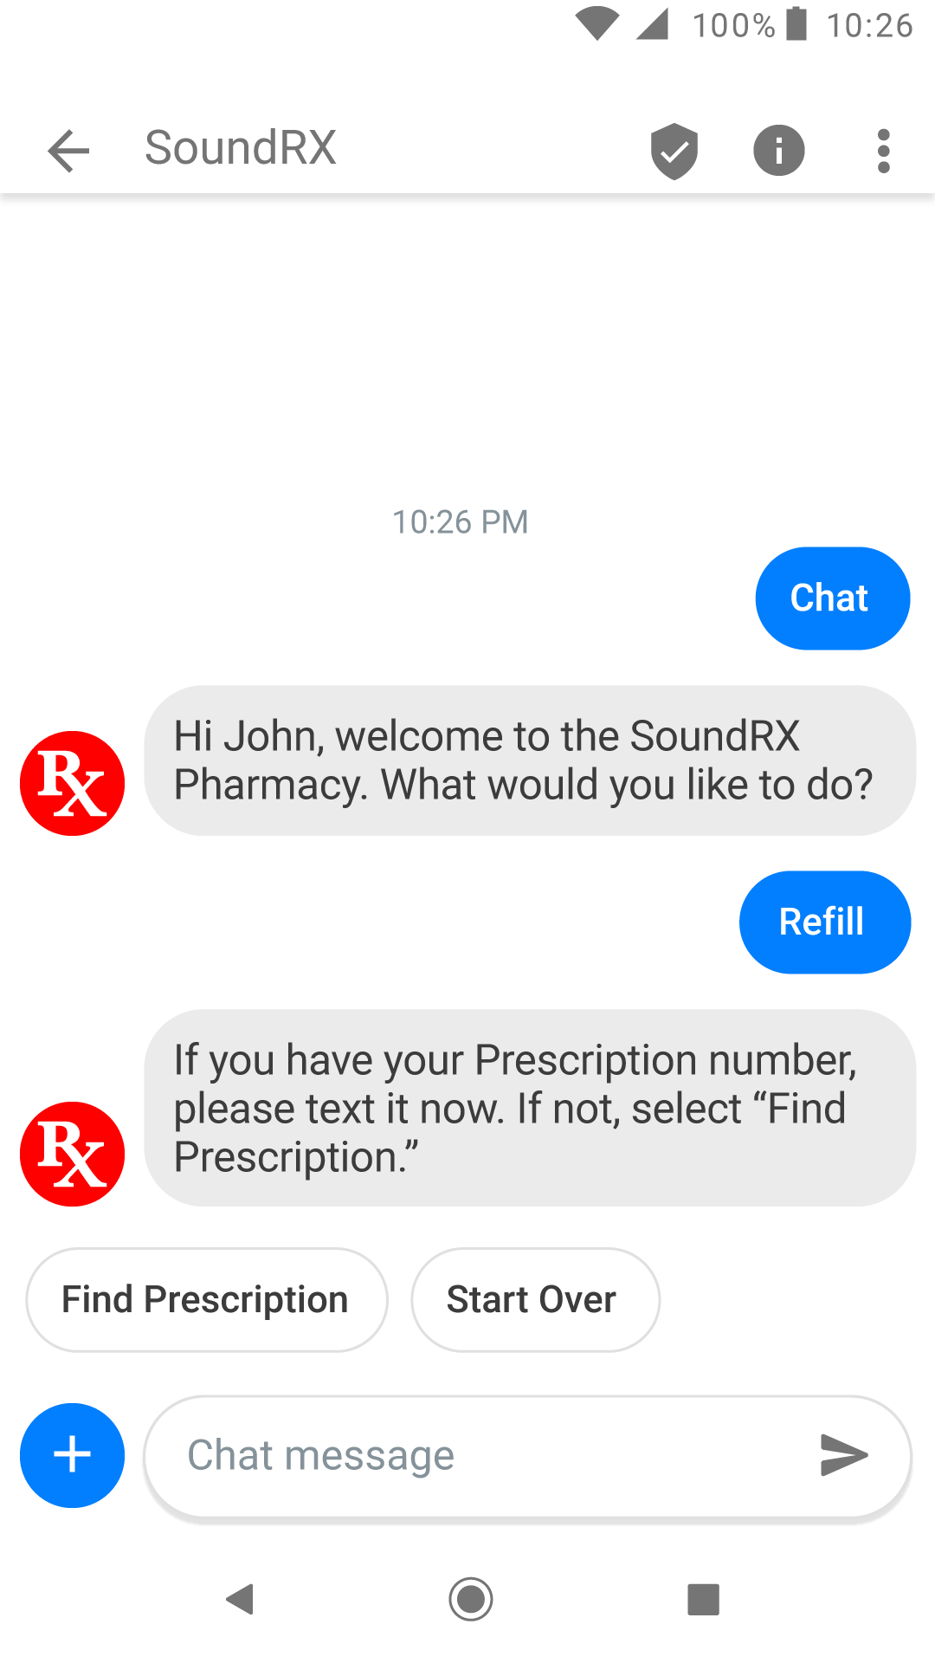
RCS PRESCRIPTION REFILL
CHATBOT DIRECTORY
CHATBOT BRAND DIRECTORY HOME PAGE

Slide 4
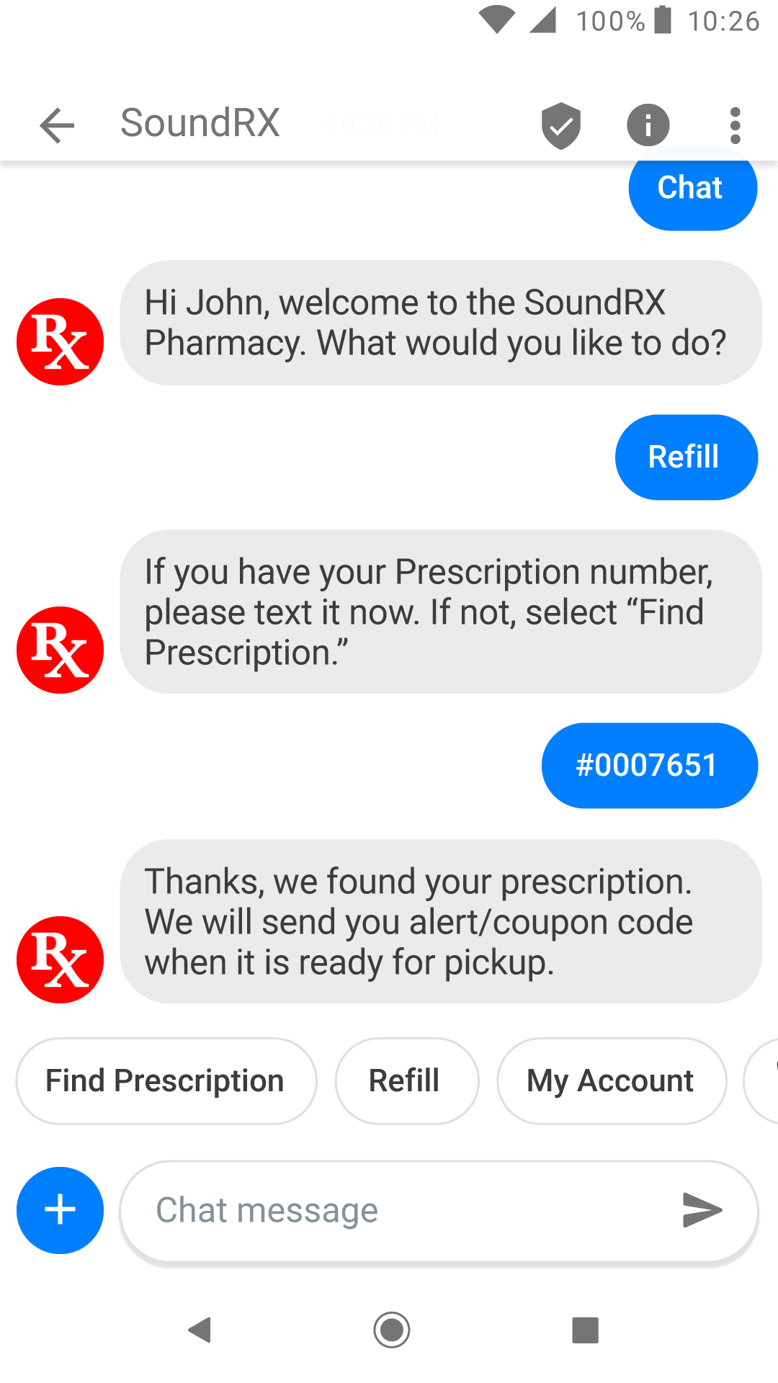
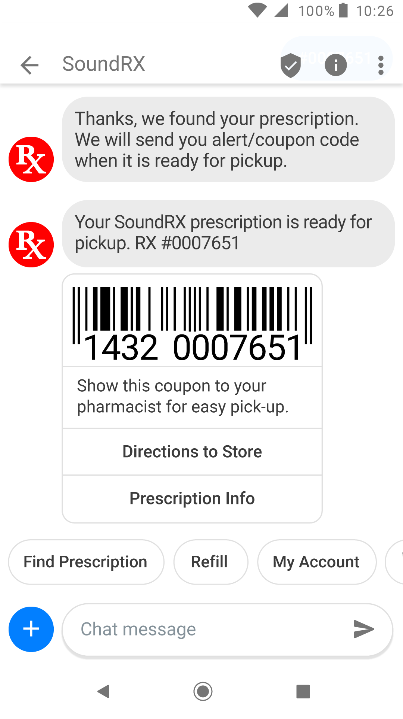
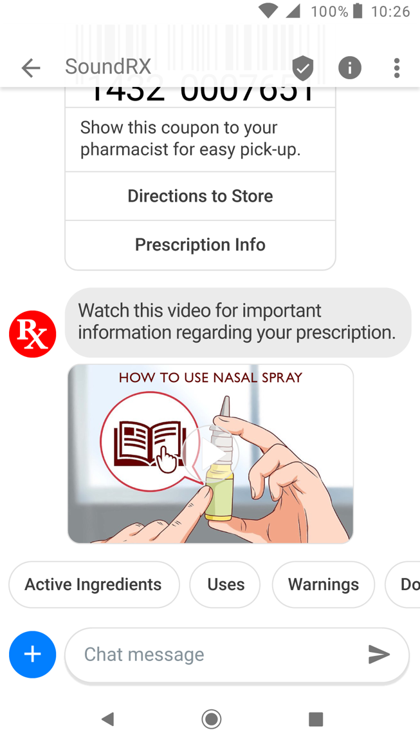
RCS PRESCRIPTION REFILL

